Slide 1
Financial and/or Ethical Crisis: Values and the Future of Business
Marc Le Menestrel

Slide 2
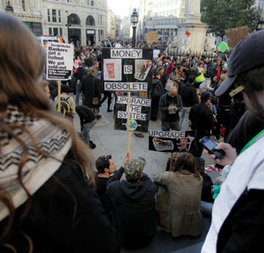
2011 Wall Street protests strikingly resembles the situation describes in this 2008 case

Slide 3
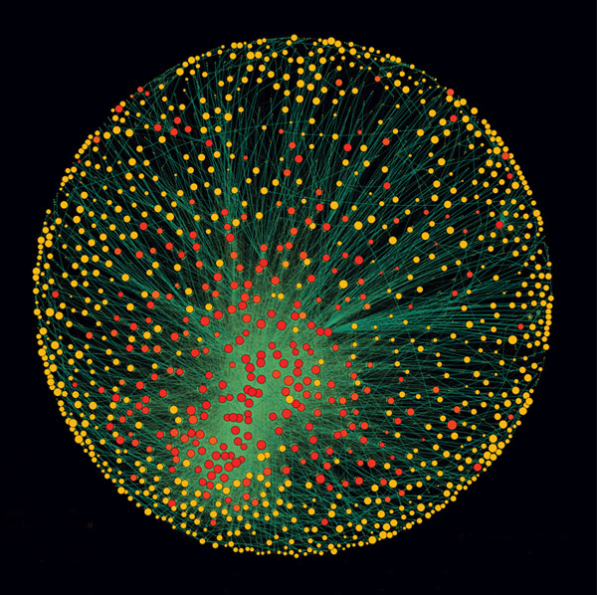
The Network of Global Corporate Control (from Vitali et al., PLoS ONE, 2011)

Slide 4
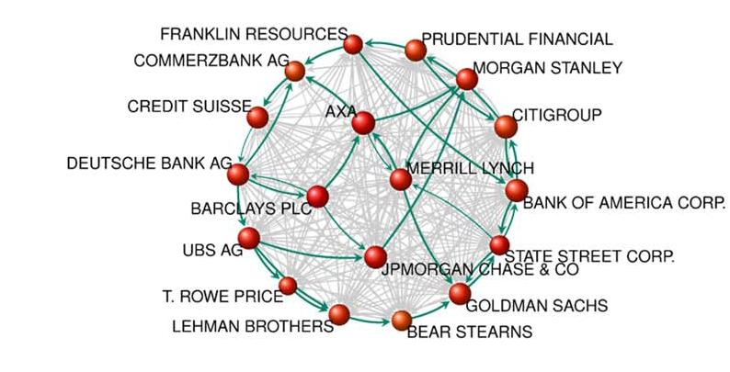
A Zoom on the network of major actors in the financial sector (Source: Vitali & al., PLoS ONE, 2011)

Slide 5
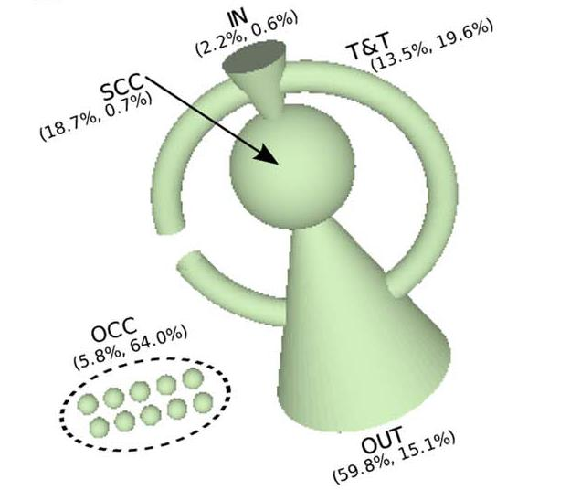
The Topology of Global Corporate Control: nearly 40% of the control over the economic value of corporations in the world is held by a group of 147 corporations in the core, which has almost full control over itself. (Source: Vitali et al., PLoS ONE, 2011)

Slide 6
The Cree Prophecy
Only after the last tree has been cut down
Only after the last fish has been caught
Only after the last river has been poisoned
Only then will you find money cannot be eaten

